Slide 1
Linear Inequalities
Wolff algebra 1H

Slide 2
What’s to remember?
Identify or get the inequality in slope-intercept, point-slope, or standard form
If standard form, calculate the intercepts
Plot points on the graph
> or < calls for a dashed line
≥ or ≤ calls for a solid line
Shade above or below the line
Use y-intercept as a guide
You might have to convert standard form to be sure ☺

Slide 3
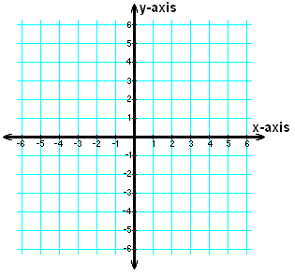
Let’s start easy ☺ with slope-intercept
y ≤ x – 4

Slide 4
How’d you do?
y ≤ x – 4
= shaded area

Slide 5
Point-Slope
y – 2 ≥ -3(x + 2)

Slide 6
How did you do?
y – 2 ≥ -3(x + 2)

Slide 7
Standard Form
2x – 4y > 6

Slide 8
How did you do?
2x – 4y > 6
The catch!
y < ½ x – 1.5

Slide 9
Don’t forget the basics!
y < 3 x ≥ -4

Slide 10
Don’t forget the basics!
y < 3 x ≥ -4

